Slide 1
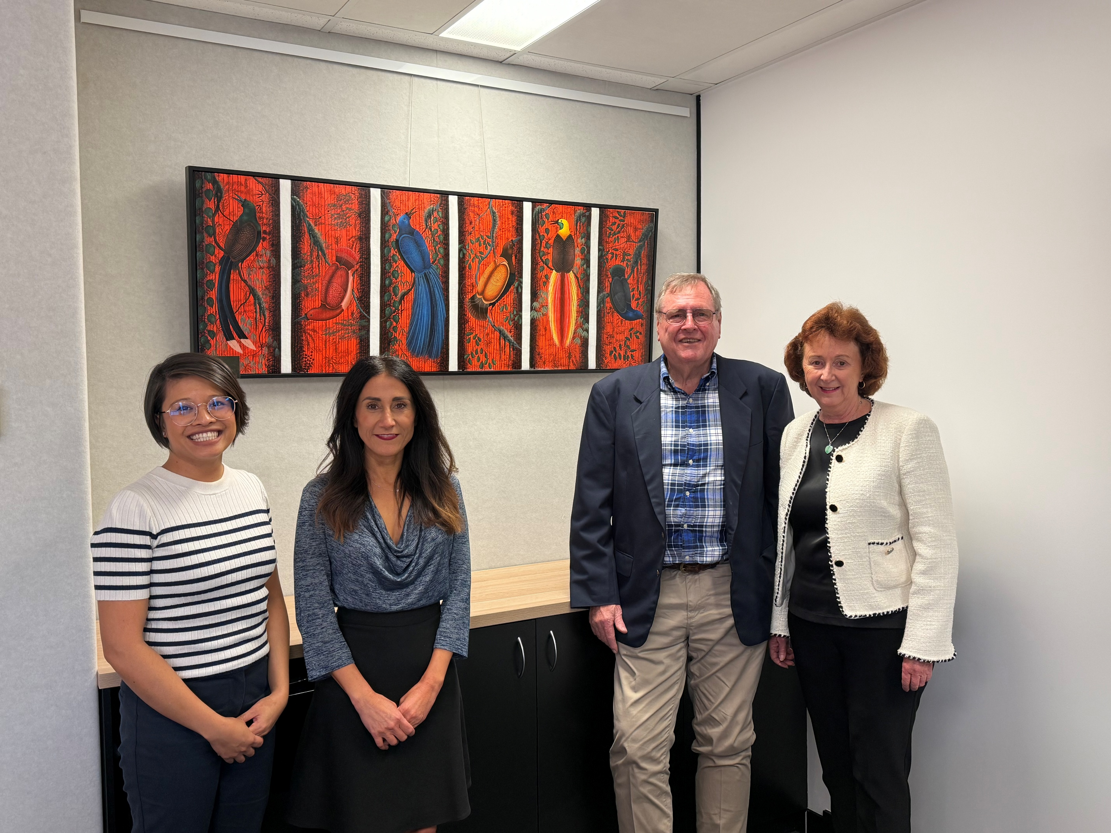
July 2025
The Real Estate Industry Queensland (REIQ) is one of Australia’s leading professional bodies for real estate practioners and has a long standing relationship with Real Estate Industry Association of PNG (REIA).
Through this partnership, both organisations aim to support the development of professional knowledge, practical skills and industry standards for real estate practitioners in Papua New Guinea.
REIA President Mike Quinn presenting REIQ CEO Antonia Mercorella and REIQ General Counsel Kat Beavon, REIQ trainer Le-Anne Allan with bird of paradise paintings in appreciation for REIQ’s continued support and partnership in delivering real estate training and expertise.

